Slide 1
DATA STRUCTURES AND ALGORITHMS
GRAPH

Slide 2
GRAPH
Graph G consist of
Set of vertices V (called nodes), (V = {v1, v2, v3, v4......})
Set of edges E (i.e., E {e1, e2, e3......cm}
A graph can be represents as G = (V, E), where V is a finite and non empty set at vertices and E is a set of pairs of vertices called edges.
Each edge ‘e’ in E is identified with a unique pair (a, b) of nodes in V, denoted by e = [a, b].

Slide 3
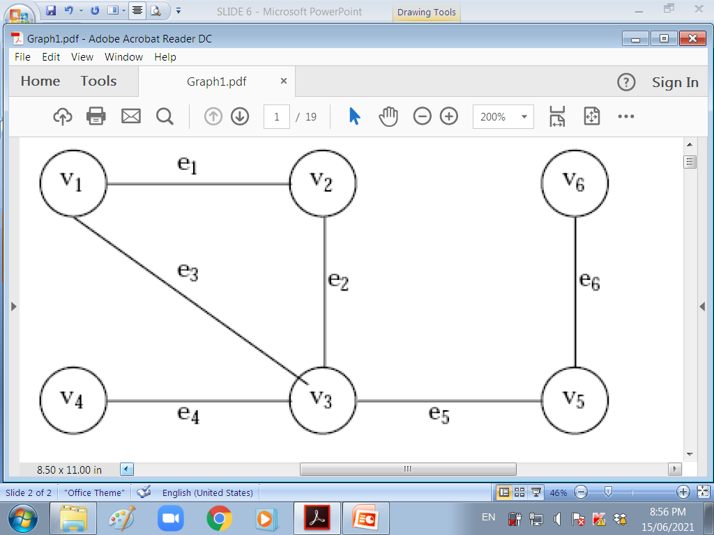

Slide 4
Consider the graph G, above:
Then the vertex V and edge E can be represented as:
V = {v1, v2, v3, v4, v5, v6}
E = {e1, e2, e3, e4, e5, e6} or
E = {(v1, v2) (v2, v3) (v1, v3) (v3, v4), (v3, v5) (v5, v6)}.
There are six edges and vertex in the graph

Slide 5
BASIC TERMINOLOGIES
A directed graph G is defined as an ordered pair (V, E) where, V is a set of vertices and the ordered pairs in E are called edges on V.
A directed graph can be represented geometrically as a set of marked points (called vertices) V with a set of arrows (called edges) E between pairs of points (or vertex or nodes) so that there is at most one arrow from one vertex to another vertex.

Slide 6
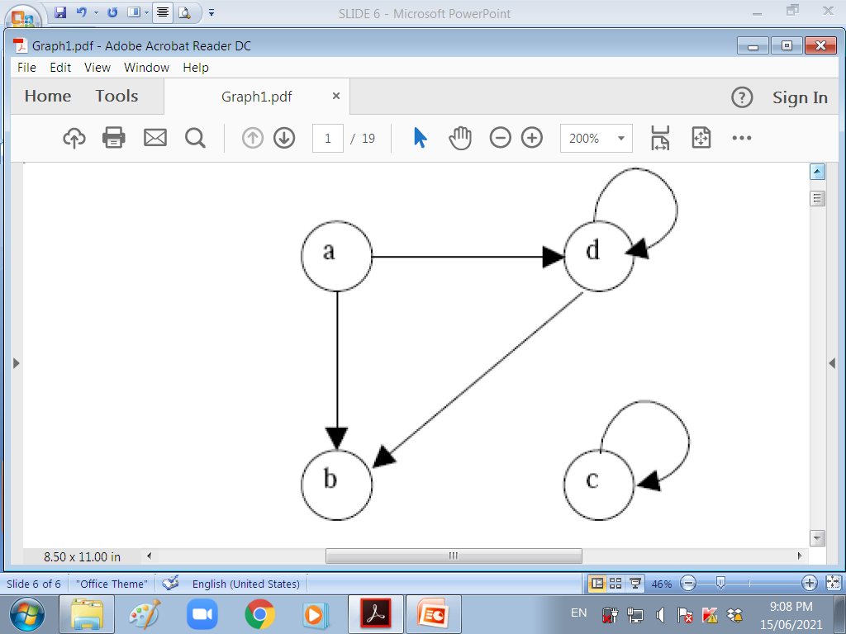
For example, the Graph below shows a directed graph, where G = {a, b, c, d }, {(a, b), (a, d), (d, b), (d, d), (c, c)}

Slide 7
An edge (a, b), in said to the incident with the vertices it joints, i.e., a, b. We can also say that the edge (a, b) is incident from a to b.
The vertex a is called the initial vertex and the vertex b is called the terminal vertex of the edge (a, b).
If an edge that is incident from and into the same vertex, say (d, d) of (c, c) , it is called a loop.

Slide 8
Two vertices are said to be adjacent if they are joined by an edge.
Consider edge (a, b), the vertex a is said to be adjacent to the vertex b, and the vertex b is said to be adjacent from the vertex a.
A vertex is said to be an isolated vertex if there is no edge incident with it. eg vertex C is an isolated vertex.

Slide 9
An undirected graph G is defined abstractly as an ordered pair (V, E), where V is a set of vertices and the E is a set at edges.
An undirected graph can be represented geometrically as a set of marked points (called vertices) V with a set at lines (called edges) E between the points

Slide 10
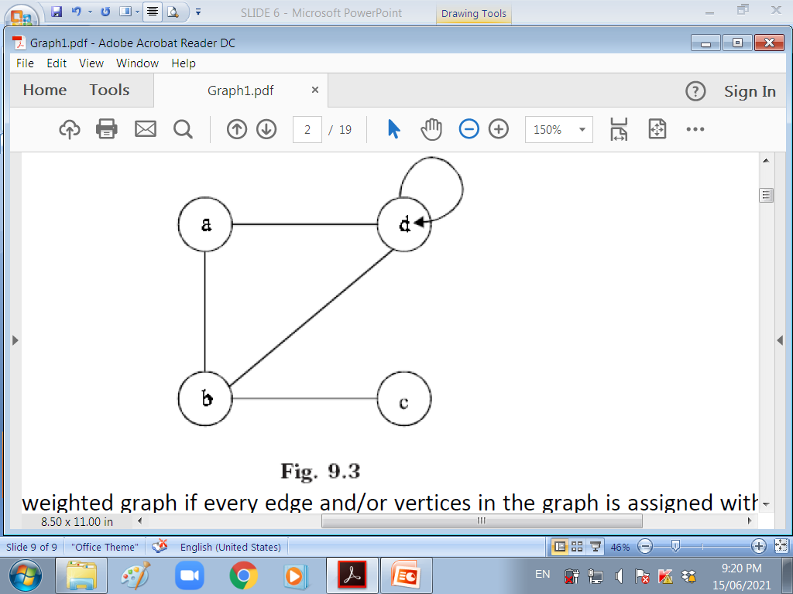

Slide 11
A graph G is said to be weighted graph if every edge and/or vertices in the graph is assigned with some weight or value.
A weighted graph can be defined as G = (V, E, We, Wv) where V is the set of vertices, E is the set at edges and We is a weights of the edges whose domain is E and Wv is a weight to the vertices whose domain is V.
Consider a graph below which shows the distance in km between four metropolitan towns in Kenya.

Slide 12
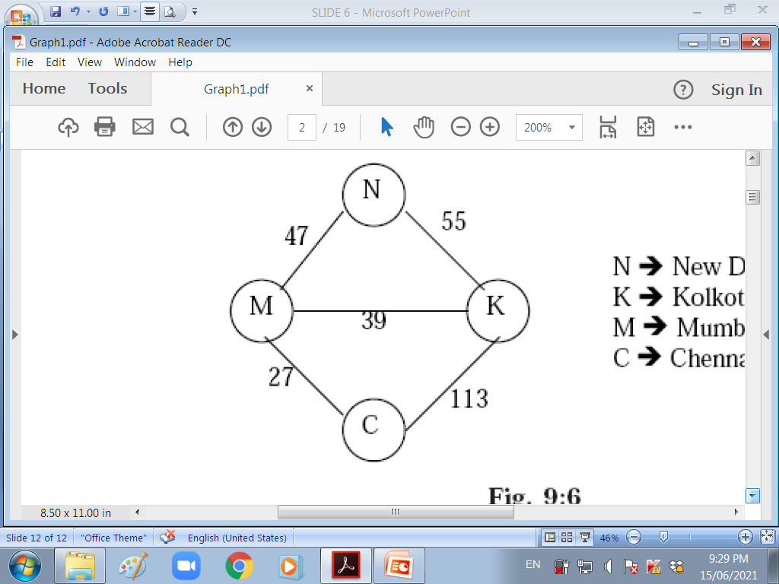

Slide 13
Here V = {N, K, M, C,} E = {(N, K), (N,M,), (M,K), (M,C), (K,C)} We = {55,47, 39, 27, 113} and Wv = {N, K, M, C}
The weight at the vertices is not necessary to maintain since the set Wv and V are same.
An undirected graph is said to be connected if there exist a path from any vertex to any other vertex. Otherwise it is said to be disconnected.

Slide 14
A graph G is said to complete (or fully connected or strongly connected) if there is a path from every vertex to every other vertex.
If a and b are two vertices in the directed graph, then it is a complete graph if there is a path from a to b as well as a path from b to a. A complete graph with n vertices will have n (n – 1)/2 edges.
The figures below illustrates the complete undirected graph and complete directed graph.

Slide 15
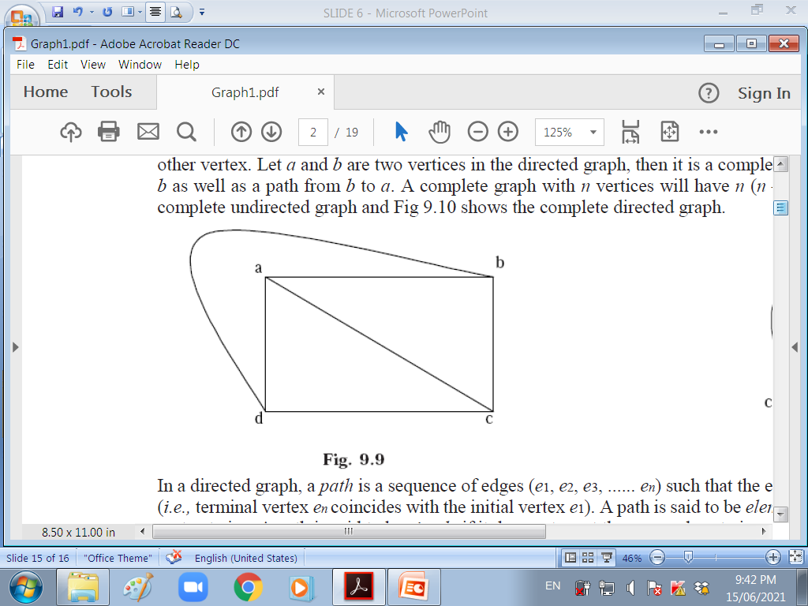
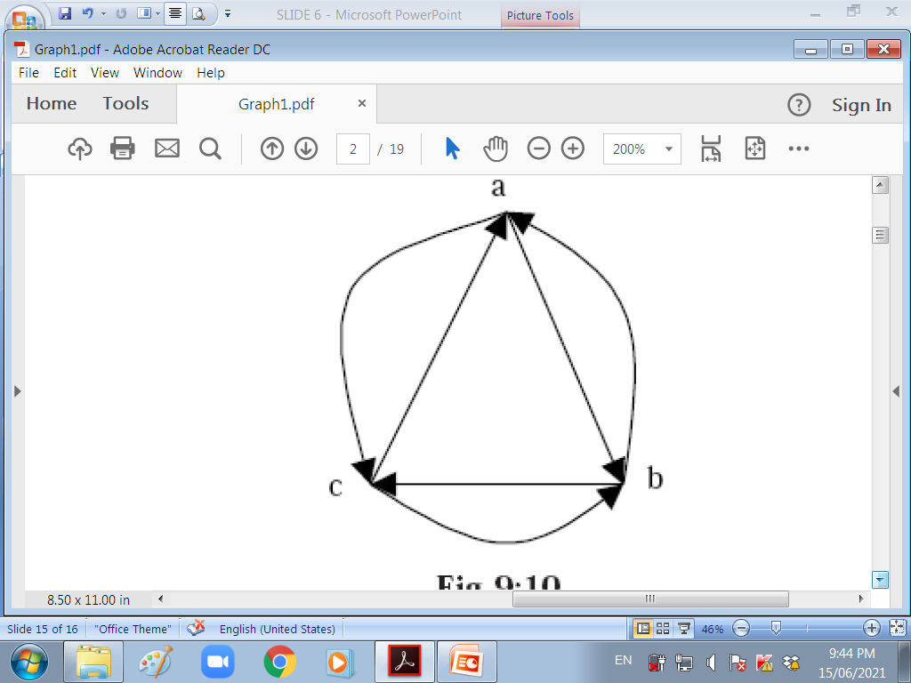

Slide 16
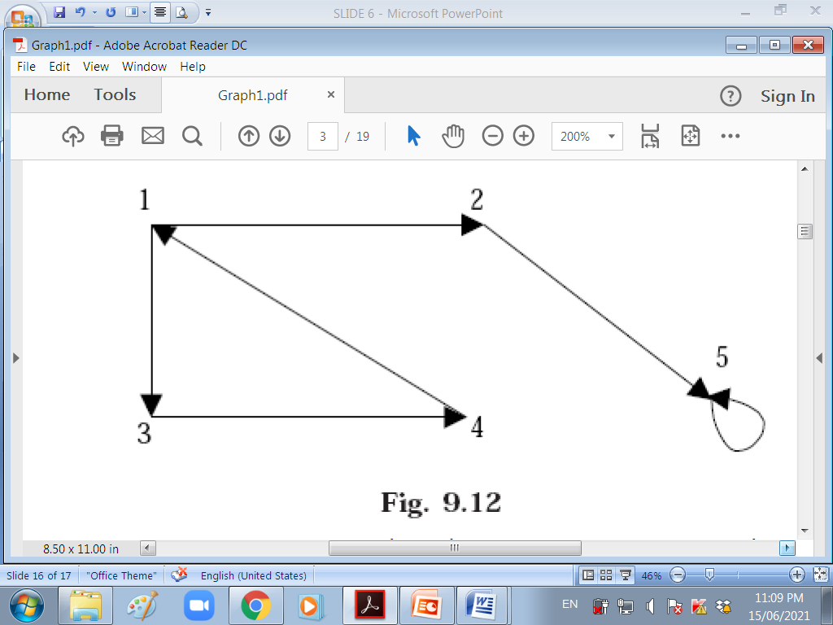
REPRESENTING A GRAPH

Slide 17
ADJACENCY MATRIX REPRESENTATION
The adjacency matrix A of a directed graph G = (V, E) can be represented with the following conditions
Aij = 1 {if there is an edge from Vi to Vj or if the edge (i, j) is member of E.}
Aij = 0 {if there is no edge from Vi to Vj}

Slide 18
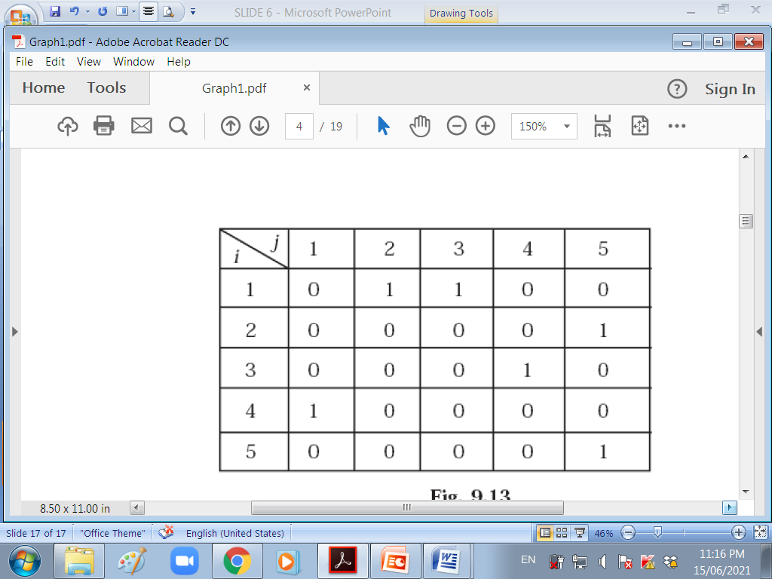

Slide 19
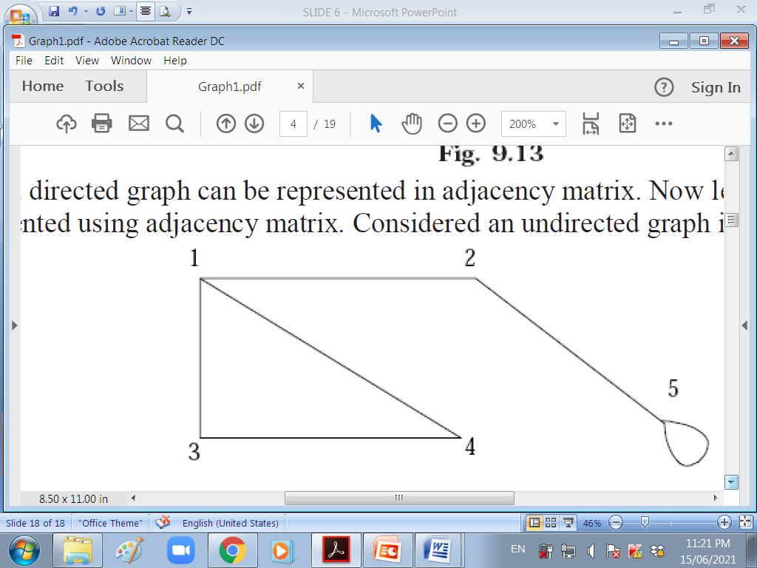
UNDIRECTED GRAPH

Slide 20
The adjacency matrix A of an undirected graph G = (V, E) can be represented with the following conditions
Aij = 1 {if there is an edge from Vi to Vj or if the edge (i, j) is member of E}
Aij = 0 {if there is no edge from Vi to Vj or the edge i, j, is not a member of E}

Slide 21
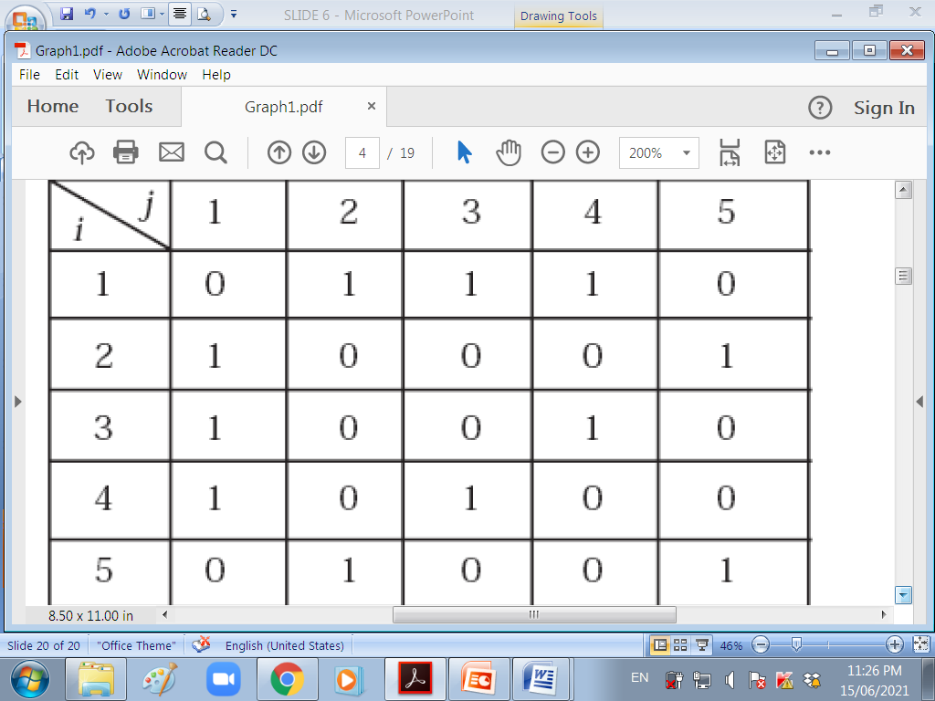

Slide 22
To represent a weighted graph using adjacency matrix, weight of the edge (i, j) is simply stored as the entry in i th row and j th column of the adjacency matrix.
The adjacency matrix A for a directed weighted graph G = (V, E, We ) can be represented as
Aij = Wij { if there is an edge from Vi to Vj then represent its weight Wij.}
Aij = – 1 { if there is no edge from Vi to Vj}

Slide 23
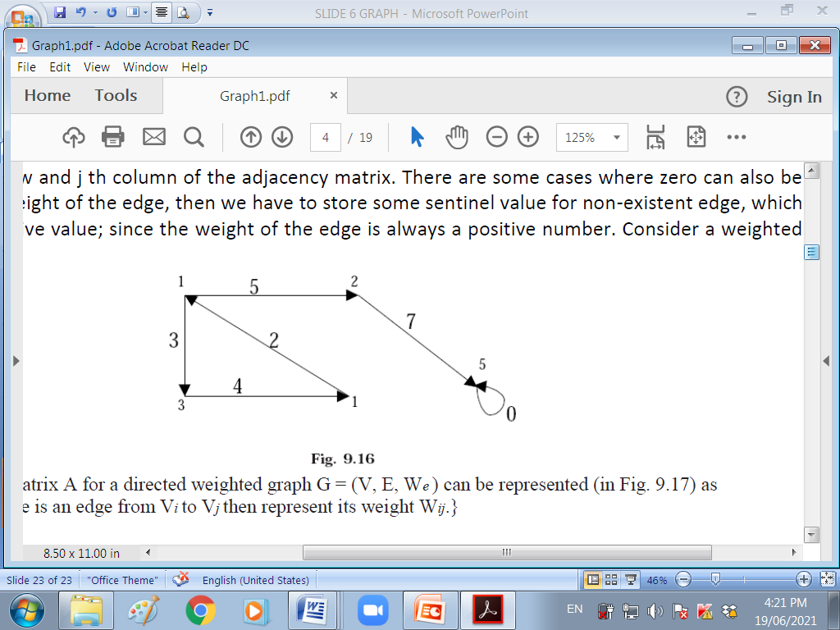
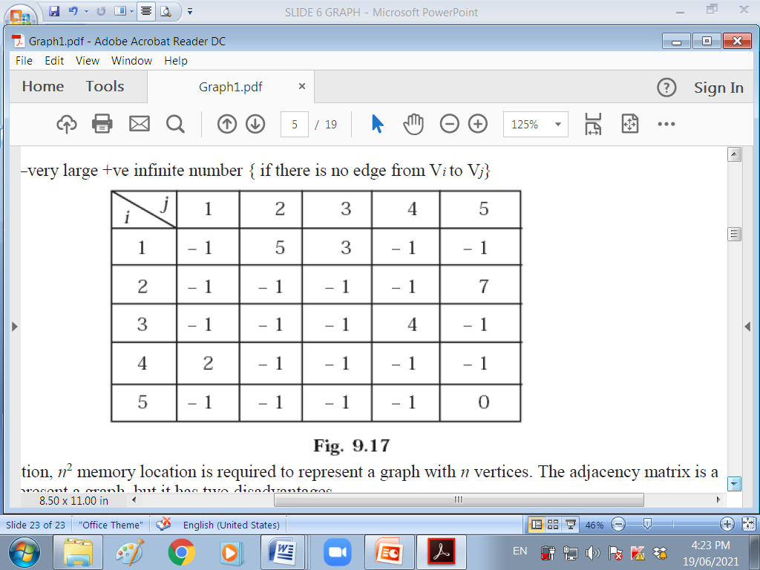

Slide 24
LINKED LIST REPRESENTATION
In this representation (also called adjacency list representation), we store a graph as a linked structure. First we store all the vertices of the graph in a list and then each adjacent vertices will be represented using linked list node. Here terminal vertex of an edge is stored in a structure node and linked to a corresponding initial vertex in the list.

Slide 25
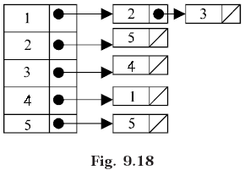

Slide 26
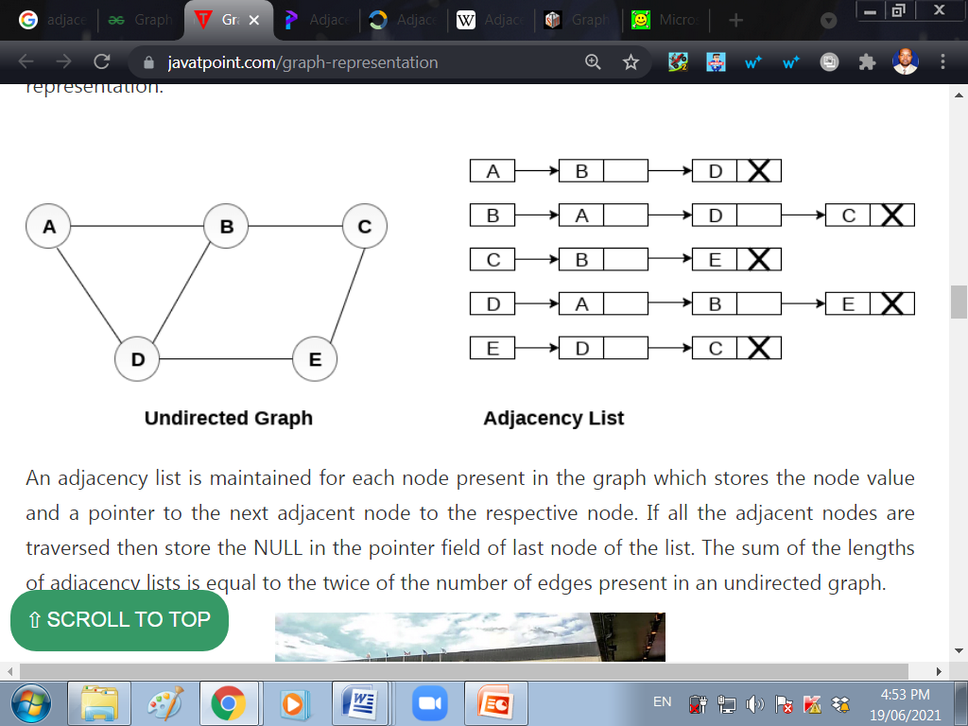

Slide 27
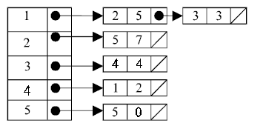

Slide 28
GRAPH TRAVERSAL METHODS
(a) Breadth First Search (BFS)
(b) Depth First Search (DFS)
Discuss each of the methods

Slide 29
GRAPH APPLICATION
Since they are powerful abstractions, graphs can be very important in modeling data. In fact, many problems can be reduced to known graph problems. Here we outline just some of the many applications of graphs.
Social network graphs: to tweet or not to tweet. Graphs that represent who knows whom, who communicates with whom, who influences whom or other relationships in social structures. An example is the twitter graph of who follows whom. These can be used to determine how information flows, how topics become hot, how communities develop, or even who might be a good match for who, or is that whom.

Slide 30
Transportation networks. In road networks vertices are intersections and edges are the road segments between them, and for public transportation networks vertices are stops and edges are the links between them. Such networks are used by many map programs such as Google maps, Bing maps and now Apple IOS 6 maps (well perhaps without the public transport) to find the best routes between locations. They are also used for studying traffic patterns, traffic light timings, and many aspects of transportation.

Slide 31
Utility graphs. The power grid, the Internet, and the water network are all examples of graphs where vertices represent connection points, and edges the wires or pipes between them. Analyzing properties of these graphs is very important in understanding the reliability of such utilities under failure or attack, or in minimizing the costs to build infrastructure that matches required demands.

Slide 32
Document link graphs. The best known example is the link graph of the web, where each web page is a vertex, and each hyperlink a directed edge. Link graphs are used, for example, to analyze relevance of web pages, the best sources of information, and good link sites.
Protein-protein interactions graphs. Vertices represent proteins and edges represent interactions between them that carry out some biological function in the cell. These graphs can be used, for example, to study molecular pathways—chains of molecular interactions in a cellular process. Humans have over 120K proteins with millions of interactions among them.

Slide 33
. Network packet traffic graphs. Vertices are IP (Internet protocol) addresses and edges are the packets that flow between them. Such graphs are used for analyzing network security, studying the spread of worms, and tracking criminal or non-criminal activity.
Scene graphs. In graphics and computer games scene graphs represent the logical or spacial relationships between objects in a scene. Such graphs are very important in the computer games industry.

Slide 34
Robot planning. Vertices represent states the robot can be in and the edges the possible transitions between the states. This requires approximating continuous motion as a sequence of discrete steps. Such graph plans are used, for example, in planning paths for autonomous vehicles.
Neural networks. Vertices represent neurons and edges the synapses between them. Neural networks are used to understand how our brain works and how connections change when we learn. The human brain has about 1011 neurons and close to 1015 synapses.

Slide 35
Semantic networks. Vertices represent words or concepts and edges represent the relationships among the words or concepts. These have been used in various models of how humans organize their knowledge, and how machines might simulate such an organization.
Graphs in epidemiology. Vertices represent individuals and directed edges the transfer of an infectious disease from one individual to another. Analyzing such graphs has become an important component in understanding and controlling the spread of diseases.

Slide 36
Graphs in compilers. Graphs are used extensively in compilers. They can be used for type inference, for so called data flow analysis, register allocation and many other purposes. They are also used in specialized compilers, such as query optimization in database languages.
Constraint graphs. Graphs are often used to represent constraints among items. For example the GSM network for cell phones consists of a collection of overlapping cells. Any pair of cells that overlap must operate at different frequencies. These constraints can be modeled as a graph where the cells are vertices and edges are placed between cells that overlap.

Slide 37
END.
WAIRAGU G.R.

